Slide 1
Solving Equations Using the Graphical Method

Slide 2
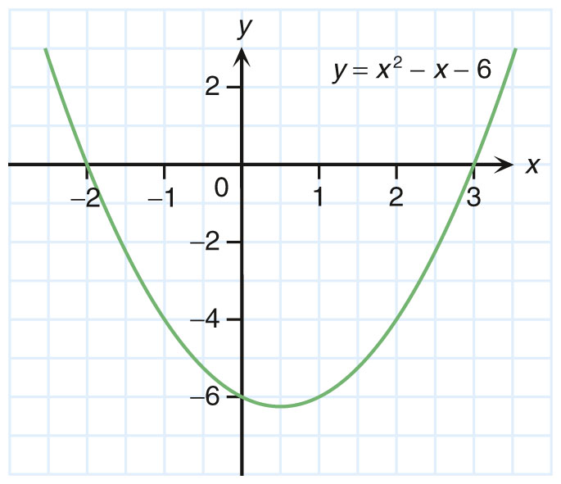


Do you remember how to solve
x² – x – 6 = 0 using the graph of
y = x² – x – 6?
Yes. We can find the x-intercept(s) of the graph of y = x² – x – 6 first.

Slide 3

Solve x² – x – 6 = 0 using the
graph of y = x² – x – 6.
y = 0
solution
solution
Good! When solving x² – x – 6 = 0, we
know that the solutions are the x-coordinates
of the points of intersection between
y = x² – x – 6 and y = 0.
(i.e. x = −2 or 3)

Slide 4


Can we solve the equation
x² – x – 6 = –4 using
the graph of y = x² – x – 6 ?
Yes. Let me show you
how to do so.

Slide 5
Step 1
Rewrite the equation as
y = x² – x – 6
.
y = −4
y = –4
Step 2
Draw the horizontal line
y = −4 on the graph of
y = x² – x – 6.

Slide 6
Step 3
Find the solutions of
x² – x – 6 = –4 by reading
the x-coordinates of the
points of intersection
between y = x² – x – 6 and
y = –4.
solution
solution
y = –4
Intersection of the two graphs
Intersection of the two graphs

Slide 7

Step 3
The solutions of
x² – x – 6 = –4 are
x = −1.0 or 2.0.
solution
solution
y = –4
The grid lines on the graph paper
determine the accuracy of the solution
that can be obtained.

Slide 8
Step 3
The solutions of
x² – x – 6 = –4 are
x = −1.0 or 2.0.
solution
solution
y = –4
The scale of the x-axis in the above
figure allows us to read the values
of x correct to the nearest 0.5.

Slide 9


How about graphs with
no intersections?
There are no real solutions
for the equation.
Let us consider an example:
Solve x² – x – 6 = –7 graphically
Step 1
Rewrite the equation as
y = x² – x – 6
.
y = −7
The two graphs
do not intersect.
Step 2
Draw the horizontal line y = −7 on the graph of y = x² – x – 6.
y = –7

Slide 10
Actually, the graphical method is
not limited to quadratic equations.

Slide 11
In general, if the graph of y = f(x) is given, we can solve the equation f(x) = k,
where k is a constant, using graphical method.
The procedure is as follows:

Slide 12


y
y = k
y = f(x)
x
0
Solution
Solution
Solution
Step 1
Rewrite the equation as
.
Step 2
Draw the horizontal line y = k on the graph of y = f(x).
Step 3
Find the solutions of f(x) = k by reading the
x-coordinate(s) of the points of intersection between y = f(x) and y = k.

Slide 13
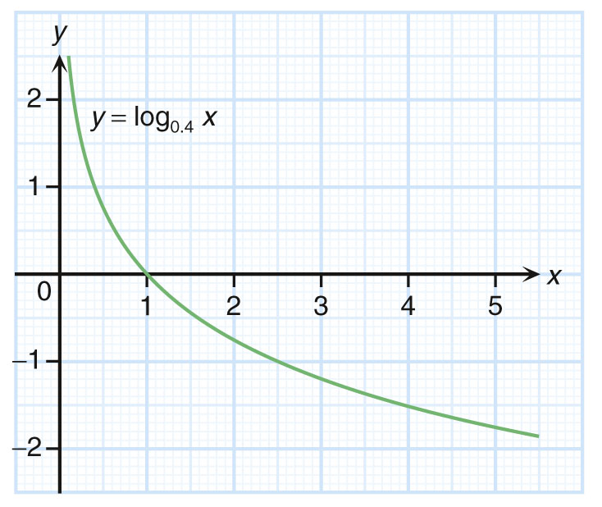
Follow-up question
Given the graph of y = log_{0.4} x, solve the equation log_{0.4} x = –1 graphically.
Draw the horizontal line y = –1
on the graph of y = log_{0.4} x.
∵ The two graphs intersect
at x = 2.5.
∴ The solution of
log_{0.4} x = –1 is x = 2.5.
y = –1

Slide 14
We can also solve the equation
af(x) + b = k using the
graph of y = f(x).

Slide 15
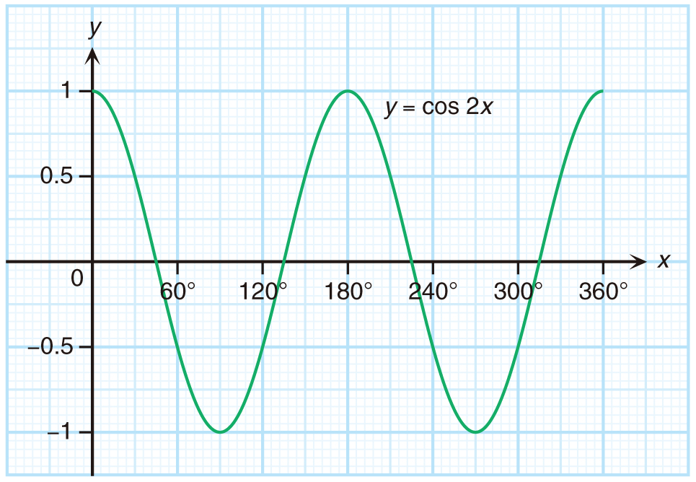
Example:
The figure shows the graph of y = cos 2x for 0° ≤ x ≤ 360°.
Solve the equation 2 cos 2x – 1 = 0 for 0° ≤ x ≤ 360° graphically.
2 cos 2x – 1 = 0
2 cos 2x = 1
cos 2x = 0.5
First, rewrite it into the form cos 2x = k.
Now, we need to solve cos 2x = 0.5.

Slide 16
Example:
The figure shows the graph of y = cos 2x for 0° ≤ x ≤ 360°.
Solve the equation 2 cos 2x – 1 = 0 for 0° ≤ x ≤ 360° graphically.
2 cos 2x – 1 = 0
2 cos 2x = 1
cos 2x = 0.5
y = 0.5
Draw the horizontal line
y = 0.5 on the graph of
y = cos 2x .
∵ The two graphs intersect
at x = 30°, x = 150°,
x = 210° and x = 330°.
∴ The solutions of 2 cos 2x – 1 = 0 are x = 30°, 150°,
210° or 330°.

Slide 17
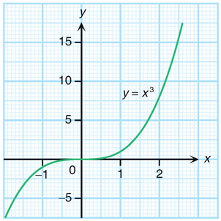
Follow-up question
The figure shows the graph of y = x³.
(a) Rewrite the equation
into the form x³ = k,
where k is a constant.
(b) Hence, solve the equation
graphically.
(a)
1
x
3
=
4
3
x
3
=
12

Slide 18
Follow-up question
(b) Draw the horizontal line y = 12
on the graph of y = x³.
y = 12
∵ The two graphs intersect at
x = 2.3.
∴ The solution of
is x = 2.3.

